Slide 1

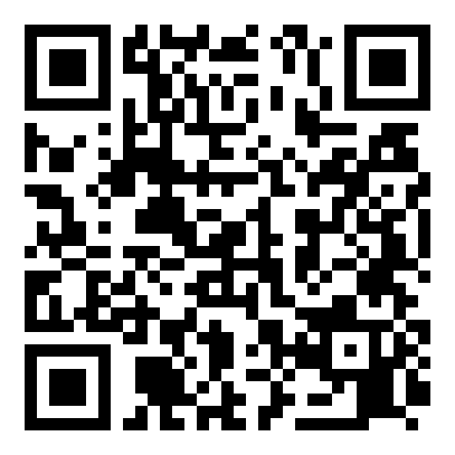
ORGANIZATIONAL TRUST QUOTIENT®
Reading team health
from everyday messages
How people talk at work → a signal of how the team is doing
Scan to request a briefing
Vernon T. Cox · Srilatha Alla
CNM Ingenuity — Data Science Bootcamp Capstone
Instructor: Robert Citek
SME: Prof. R. DelCampo — UNM Anderson
Notes:
SPEAKER: Vernon & Srilatha
1. Welcome — I'm Vernon Cox, with my co-researcher Srilatha Alla.
2. We built the Organizational Trust Quotient, or OTQ.
3. The idea: how a team talks day to day — how often they message, how fast they reply — signals how the team is doing.
4. We don't survey anyone and we never read messages; we use patterns that are already there.
5. Today I'll cover the problem, what we measure, the data, and the working tool we built.

Slide 2





PREVIEW — WHAT WE'LL COVER
The next 10 minutes
Scan · Request a briefing
1
The problem we set out to solve
2
What OTQ looks at
3
The data — and how we score it
4
Results & the dashboard we built
5
Take-homes & what's next
02
Notes:
SPEAKER: Vernon
1. Here's the quick roadmap for the next ten minutes.
2. First, the problem — why this is harder than it sounds.
3. Then what OTQ looks at, and the data behind it.
4. Then the results and the website we built.
5. Finally, the takeaways and where we'd go next.
6. I'll keep it plain — no data degree required.

Slide 3

THE BUSINESS PROBLEM
Unfocused, disjointed, unheard teams cost time and money
Scan · Request a briefing
+
+
PULLED APART
WALLED OFF
TUNED OUT
Unfocused
Disjointed
Unheard
effort scatters, priorities blur
work duplicated, handoffs dropped
concerns surface too late
The cost: Across every company this quietly drains hours, slows delivery, and pushes good people out — real money leaders rarely see.
03
Notes:
SPEAKER: Vernon
1. Let's start with why this matters in dollars.
2. Unfocused — everyone's busy, but pulling in different directions.
3. Disjointed — work happens in silos; things get duplicated or dropped between people.
4. Unheard — concerns surface too late, after they've become real problems.
5. None of these show on a balance sheet, but all of them burn hours, slow projects, and push good people out.
6. That's real money — leaders just rarely see it until it's late.

Slide 4

THE PROBLEM
Trust is hard to see — until it's gone
Scan · Request a briefing
The usual way: periodic surveys
DAYS BETWEEN CHECK-INS
30–365
Annual, quarterly, pulse, 360° — methods & timing vary
People answer how they “should”
Takes time away from work
Teams send thousands of
messages a day — unused
Our goal: an always-on read — with no extra work
04
Notes:
SPEAKER: Vernon
1. How do companies check on this today? Mostly surveys — annual, quarterly, pulse.
2. Surveys only happen now and then, so problems get spotted months late.
3. People tend to answer how they think they're supposed to.
4. And they pull everyone away from real work to fill them out.
5. Meanwhile, teams send thousands of messages a day — a signal that goes unused.
6. Our goal: an always-on read, with no extra work for anyone.

Slide 5
WHAT OTQ LOOKS AT
From “how people talk” to “how the team is doing”
Scan · Request a briefing
→
→
WE MEASURE
WE PREDICT
WE'RE AFTER
Engagement
Responsiveness
Trust
how much people talk & meet
how fast they reply
the thing underneath — inferred
Being honest: we measure talk and predict replies. Trust is what we believe sits underneath — we don't claim to measure it directly.
05
Notes:
SPEAKER: Vernon
1. Here's the heart of it — and I'll be straight about each step.
2. We measure engagement — how much a team talks and meets.
3. From that, we predict responsiveness — how fast they reply.
4. What we're really curious about underneath is trust.
5. The honest part: we measure talk and predict replies; trust is what we believe sits underneath.
6. We do NOT claim to measure trust directly — and we keep that front and center.

Slide 6





THE DATA · WHERE IT COMES FROM
Three everyday tools, one combined table
Scan · Request a briefing
→
Slack
Teams
Outlook
1,250 events
in one table
500 chat messages
400 meetings
350 calendar invites
Practice data: the “Apostles” dataset
No real company yet — so we built safe stand-in data from Bible figures (the apostles). Same shape as real Slack / Teams / Outlook exports, so the code is ready for the real thing.
06
Notes:
SPEAKER: Vernon
1. The data comes from three tools every office already uses.
2. Slack for chats, Teams for meetings, Outlook for calendar invites.
3. We combine them into one table — here, about 1,250 events.
4. No real company yet, so we built safe stand-in data using apostle names.
5. It has the same shape as real exports — so the code is ready for the real thing.

Slide 7

THE DATA · WHAT'S IN IT
Each row is one interaction — counts, not words
Scan · Request a briefing
Source | Type | Who | Channel | Min | People | Score
Teams | meeting | Peter | council | 60 | 12 | 30.9
Slack | chat | Paul | epistles | 0 | 2 | 11.0
Outlook | meeting | James | assembly | 90 | 8 | 30.5
Slack | chat | John | acts | 0 | 4 | 12.5
What we keep
Who & where
How long
How many people
A reply-speed clue
Sample rows from the combined table. Names/channels are labels in the data — never message content.
1,250
3
8
events
sources
fields each
07
Notes:
SPEAKER: Srilatha
1. Each row is one interaction — counts and timing, never the words.
2. We keep who and where, how long, how many people, and a reply-speed clue.
3. That's it — no message content, ever.
4. About 1,250 events, three sources, roughly eight simple facts each.
5. Privacy is built in from the start, not bolted on.

Slide 8

THE DATA · HOW WE SCORE IT
Give every interaction a score
Scan · Request a briefing
Bigger score = more engagement. Meetings count more than emails; longer and more people count more.
Score one event
Start: type of interaction
Add: how long it ran
Add: how many people
Add up each day
Total score & # of events
Avg people & length
How much was written
08
Notes:
SPEAKER: Srilatha
1. We turn each interaction into a score — think of it as engagement points.
2. A meeting counts more than a quick email, because it takes more from people.
3. Longer counts more than shorter; more people counts more than fewer.
4. Each day, we add it all up — total score, number of events, average length and size.
5. Busy days score high, quiet days score low — and anyone can follow the rule.

Slide 9
UNDER THE HOOD · THE CODE
From rule to score, in real code
Scan · Request a briefing
otq_scoring.py
fit_model.py
def otq_event_units(event_type, duration, people):
t = event_type.lower()
if "meeting" in t: base = 24.5 # weighs most
elif "chat" in t: base = 9.5
elif "call" in t: base = 8.5
elif "email" in t: base = 6.0
else: base = 5.0
dur = min(duration, 120) / 60.0 # +0 to 2
reach = log(max(people,1), 2) * 1.5
return base + dur + reach
features = ["log_total_eu",
"log_total_events", "avg_participants",
"avg_duration", "log_total_text"]
# alpha tuned by GridSearchCV (5-fold)
model = Ridge(alpha=best_alpha)
model.fit(X_train, y_train)
r2 = r2_score(y_test, model.predict(X_test))
# negative coef -> more talk, faster reply
09
Notes:
SPEAKER: Srilatha
1. For the technical folks: the actual code — but you don't need to read it.
2. The top function is the rule I just described: type, plus duration, plus how many people.
3. The bottom is where we feed those daily numbers into the model.
4. The point: the plain-English idea and the code line up — nothing hidden.

Slide 10
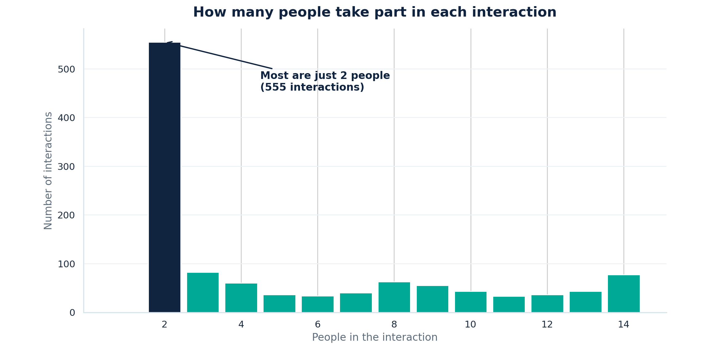
THE DATA · A FIRST LOOK
What the real numbers look like
Scan · Request a briefing
A first look at the data: most interactions are quick one-to-one exchanges, with larger group meetings making up the tail.
10
Notes:
SPEAKER: Srilatha
1. Before modeling, we always look at the data.
2. Simplest view: how many people are in each interaction.
3. The big spike on the left — most interactions are just two people.
4. The tail to the right — the bigger group meetings.
5. Nothing surprising, which is exactly what you want.

Slide 11


THE MODEL
A steady model that connects the dots
Scan · Request a briefing
What it does
How we checked it
Learns: engagement → reply speed
Our clues overlap — needs to stay steady
Ridge regression keeps it stable & readable
Compared against other models
Tuned the settings carefully
Tested on days it never saw
Ranked which clues matter most
11
Notes:
SPEAKER: Srilatha
1. The model learns the link between engagement and reply speed.
2. Our clues overlap — busy days are busy all around — so it has to stay steady.
3. We used ridge regression: stable and easy to read.
4. We checked it — compared other models, tuned carefully, tested on days it never saw.
5. We also ranked which clues matter most — we didn't just trust the first thing that worked.

Slide 12



WHAT WE BUILT
A website that runs the whole thing
Scan · Request a briefing
organizationaltrustquotient.com
Upload the files
It runs everything for you
Client data
See results & charts
We connect to your data source first — then OTQ delivers your team’s day-by-day predictions.
Day-by-day predictions
12
Notes:
SPEAKER: Srilatha
1. This isn't just a notebook — it's a real website that runs the whole thing.
2. We connect to your data source first.
3. Then OTQ delivers your team's predictions, day by day.
4. You don't touch code — it runs everything and shows results and charts.
5. The whole pipeline, wrapped in something anyone can use.

Slide 13
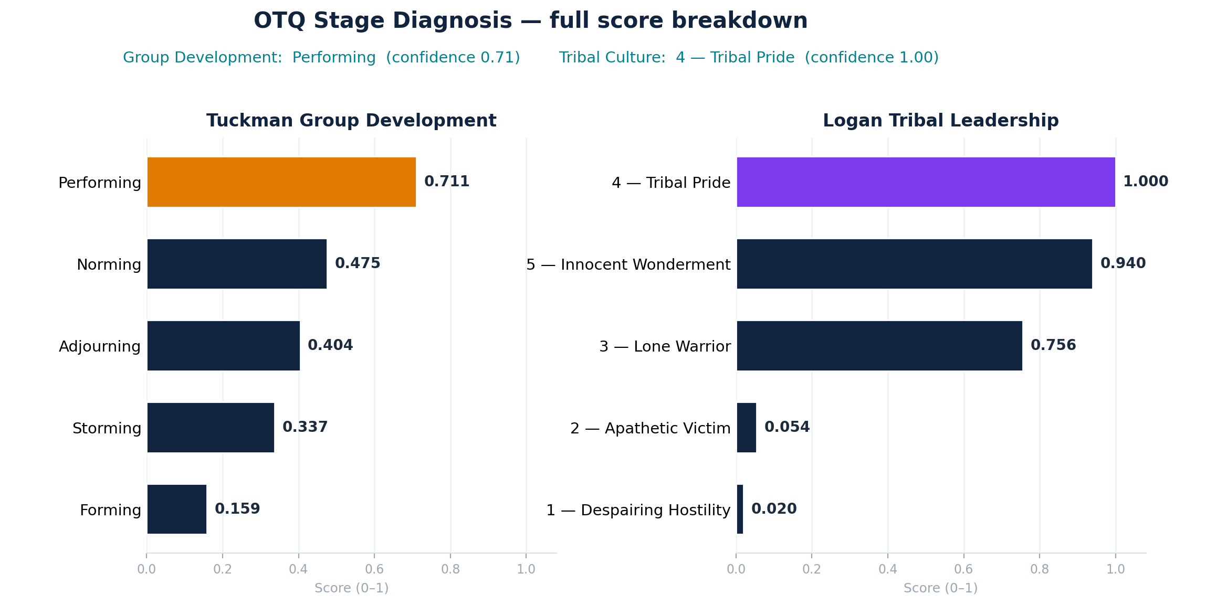
STAGE DIAGNOSIS · FULL BREAKDOWN
Every stage, scored
Scan · Request a briefing
Full Tuckman and Logan scores, ranked. An engagement-based indicator for discussion — not a validated team-development or culture diagnosis.
13
Notes:
SPEAKER: Vernon
1. We also checked whether the patterns line up with known team-development models.
2. This breaks down and ranks every stage on two well-known frameworks.
3. Caveat: it's an engagement-based indicator meant to spark discussion.
4. It is NOT a validated diagnosis of team development or culture.
5. We show the full ranking so it's transparent, not a black box.

Slide 14
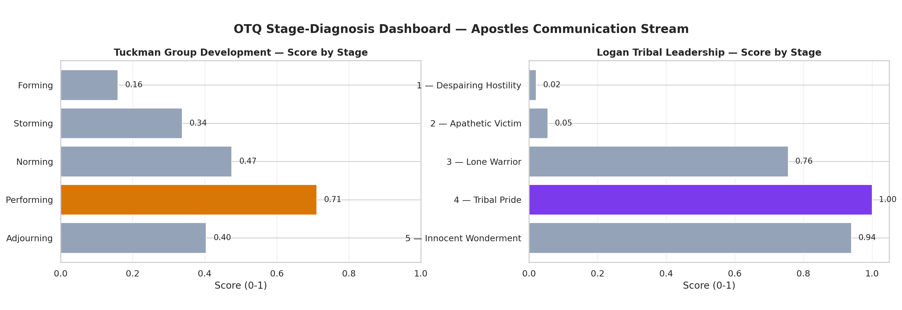
BEYOND RESPONSIVENESS · STAGE SIGNAL
Where the team sits — by stage
Scan · Request a briefing
OTQ maps the same engagement patterns onto two team-stage frameworks (Tuckman & Logan). An indicative signal to discuss — not a validated team-development or culture diagnosis.
14
Notes:
SPEAKER: Vernon
1. Here's the same idea as a picture.
2. We map the engagement patterns onto two team-stage frameworks — Tuckman and Logan.
3. The bars show where the team leans on each one.
4. Same honesty: an indicative signal to discuss, not a clinical or validated assessment.
5. It's a conversation starter — here's what the patterns suggest; does it ring true?

Slide 15
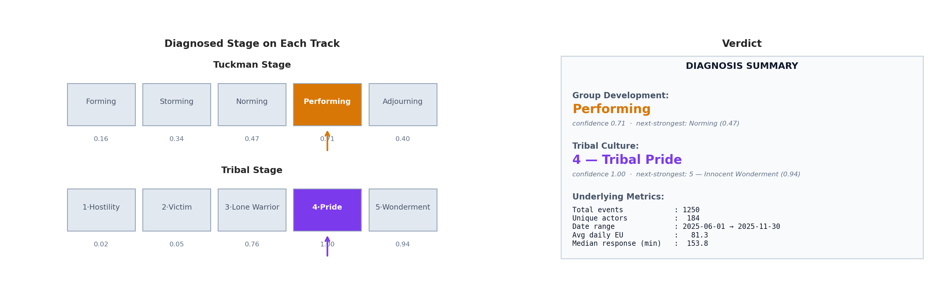
THE VERDICT
The stage read, in one view
Scan · Request a briefing
Diagnosed stage on each track with a confidence score, plus the underlying metrics (1,250 events · 184 actors · Jun–Nov 2025). An engagement-based indicator, not a clinical assessment.
15
Notes:
SPEAKER: Vernon
1. Here's the read in one view.
2. The top stage on each track, with a confidence score.
3. Plus the evidence: about 1,250 events, 184 people, over roughly six months.
4. So you get the headline and the proof together.
5. Again: an engagement-based indicator, not a clinical assessment — good for discussion, not a verdict to act on blindly.

Slide 16

TAKE-HOME POINTS
What to remember
Scan · Request a briefing
Always-on beats once a year
Talk predicts replies
a live read, not an annual survey
more engaged teams answer faster
We're honest about it
Private by design
we measure talk, not trust itself — yet
counts & timing only, no message content
16
Notes:
SPEAKER: Vernon
1. Four things to remember.
2. Always-on beats once a year — a live read beats an annual survey.
3. Talk predicts replies — more engaged teams answer faster.
4. We're honest about the limits — we measure talk, not trust itself, yet.
5. Private by design — counts and timing only, never message content.

Slide 17


WHAT'S NEXT
Next steps & questions
Where we go from here
Questions?
Check our score against a trusted trust survey
Use a real company's data
Give each team & person their own score
Track real outcomes (deadlines, tickets)
Vernon T. Cox · Srilatha Alla
Instructor: Robert Citek — CNM Ingenuity
SME: Prof. R. DelCampo — UNM Anderson
Scan to request a briefing
17
Notes:
SPEAKER: Vernon & Srilatha
1. Where we'd take this next.
2. Check our score against a trusted, established trust survey.
3. Run it on a real company's data.
4. Give each team and each person their own score.
5. Tie it to real outcomes — deadlines hit, tickets closed.
6. That's how we move from a promising signal to a proven tool. Thank you — happy to take questions.

